Slide 1
Analyzing Bias in Sources
Mashantucket Pequot Department of Education, Fall 2023
Notes:
1 min/@min 0
Hello, and welcome!
My name is Rebecca Lord Gomez and I am the Director of Education and Recreation for the Mashantucket Pequot Tribal Nation. Prior to my work at Mashantucket, I served as the Director of Middle School History for Uncommon Schools, a large charter school network centered in the New York City area.
Today, I’m excited to spend a short time digging into one of the most important aspects of history instruction: sourcing. Together, we’ll engage in an exercise to help us consider best practices for teaching about bias in sourcing to help develop critical disciplinary thinking skills in our young historians.

Slide 2

Opening Reflection
What do you look for when you source a document?
Why is it important to teach students about sourcing?
Notes:
3 min/@min 1
Let’s begin with an opening reflection. Take 1 minute to reflect on the following questions in your handout: READ QUESTIONS
1 min reflection
1 min T&T
1 min SO

Slide 3
See It: Sourcing
Prompt: What really happened at the first Thanksgiving in 1621?
Source 1: Edward Winslow, “A Relation or Journal of the Beginning and Proceedings of the English Plantation Settled at Plymouth in New England,” Mourt’s Relation, published in London, 1621.
Source 2: Ramona Peters, member of the Mashpee Wampanoag Tribe and the Tribal Nation’s Historic Preservation Officer, article in Indian Country Today, 2017.
Turn & Talk: What do you hope students would notice about these sources?
Notes:
3 min/@min 4
Thank you for sharing. We’re going to jump right into uncovering how to best teach about bias in sourcing by putting ourselves into the shoes of students in an upper middle school history class. In a moment, you’re going to read 2 sources that students could use to answer the inquiry prompt: What really happened at the first Thanksgiving in 1621?
Before you read, I want to just introduce you to the 2 sources by reviewing their source lines. The first is READ. The second is READ.
Before we begin, T&T: What do you hope students would notice about these sources?
T&T 1 min

Slide 4

See It: Sourcing
Read the 2 documents in your handout and consider:
How are the documents similar? How are they different?
What questions would you ask students to help them unpack the importance of navigating bias in sourcing?
Notes:
11 min/@min 7
Let’s go ahead and read the actual texts themselves. As you read, I want you to put on both your teacher hat and your student hat. Answer the following questions: READ
10 min to read

Slide 5

See It: Sourcing Discourse
Turn & Talk: What are your key takeaways helping students to identify bias in sourcing?
Notes:
9 min/@min 18
You have unpacked the source lines, read the documents and considered what questions you may ask your students about these sources. Let’s engage in a discussion. I’ve had with my kids about these texts.
Based on document 1, what happened at the first Thanksgiving feast of 1621?
What’s your evidence?
Winslow was a Separatist, or Pilgrim. What impact might that have on his account of this event?
Can we trust his perspective? Why or why not?
In what ways does document 2 corroborate Winslow’s account in document 1?
In what ways is document 2’s account different?
How does sourcing come into play for document 2?
Who wrote it? When was it written?
Hm, I thought that primary sources are the most reliable. Agree or disagree?
Why aren’t we reading a primary source from the Indigenous perspective from the 1620s?
What is our key takeaway about sourcing today?
Based on our reading and discussion, what actually happened during the first Thanksgiving feast in 1621?
And scene!
1 min T&T
2 min SO

Slide 6
Name It: Sourcing
Create lessons that include multiple perspectives
  ALWAYS center the voices of the historically marginalized
Identify and discuss the most relevant aspects of sourcing:
  Author’s Point of View
  Historical Context
  Intended Audience
Encourage students to be critical thinkers by inviting them to engage in discourse about sourcing with one another
  Play “volleyball” during discourse
  Ask students “agree/disagree” or to “build”
  Go beyond literal comprehension
Pre-teach relevant historical context and/or “drop the knowledge,” as needed
Notes:
1 min/@min 27
You’ve pretty much named it all. Let’s put some common language to it.

Slide 7
Core Idea
By teaching students to source what they read, we teach them to do much more than comprehend history.
We invite them to think like historians and philosopher citizens.
Notes:
1 min/@min 28
And this brings us to our Core Idea of this session. READ

Slide 8

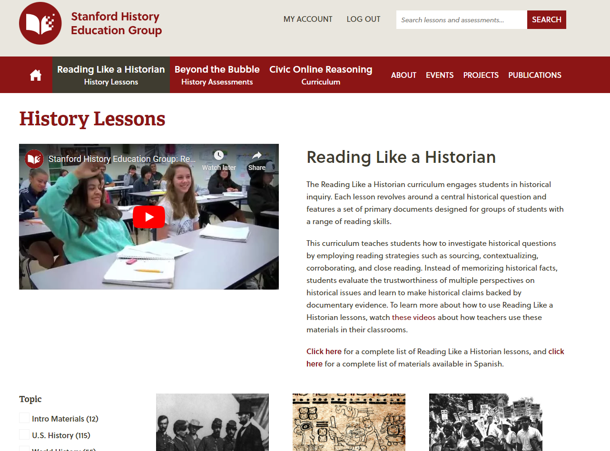
Thinking Like a Historian
Notes:
1 min/@min 29
I want to leave you with some key resources to support your working in helping our students to grow as historical thinkers and compassionate philosopher citizens.

