Slide 1
The Four Corners:
Sourcing in History Class
Analyzing Bias in Primary Sources
Notes:
1 min/@min 0
Hello, and welcome!
My name is Rebecca Lord Gomez and I am the Director of Education and Recreation for the Mashantucket Pequot Tribal Nation, located in what is now called Southeastern Connecticut. Prior to my work at Mashantucket, I served as the Director of Middle School History for Uncommon Schools, a large charter school network centered in the New York City area.
Today, I’m going to introduce a tool that I have found helps history educators better help students better think like young historians. It encourages them to source their primary source documents thoroughly, enabling them to truly analyze the biases that all humans inherently have, both in the past and today.

Slide 2
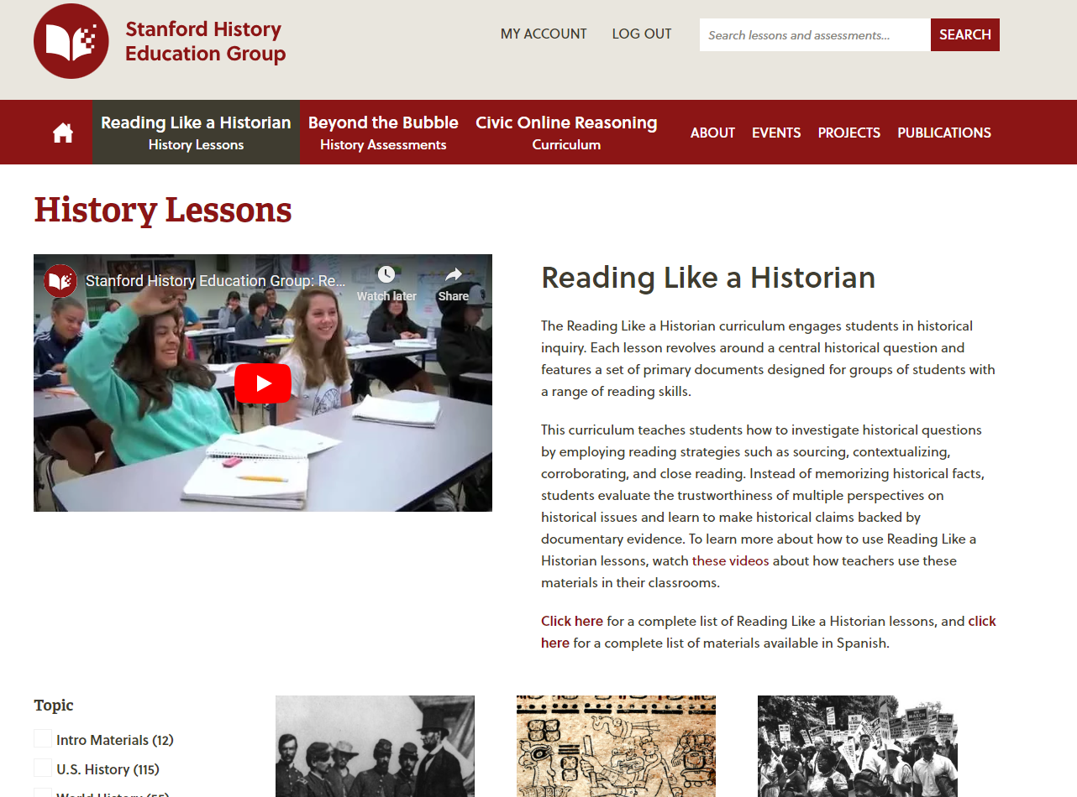
Thinking Like a Historian
Notes:
1 min/@min 1
Before we dig into today’s content, I want to first give credit where it’s due. My work as a history curriculum developer has been heavily influenced by the work of Sam Wineburg and the Stanford History Education Group. Please raise your hand if you’ve heard of or used SHEG before? If you haven’t, I highly encourage you to check Wineburg’s work out by visiting this website. He and his team do a fabulous job of basing analysis of primary source documents in historical thinking.
If you like what you experience here in our session together, please visit the SHEG site, as there are dozens of lessons you can use with your students that are already designed to mirror the exercises we’re about to do as a team.

Slide 3
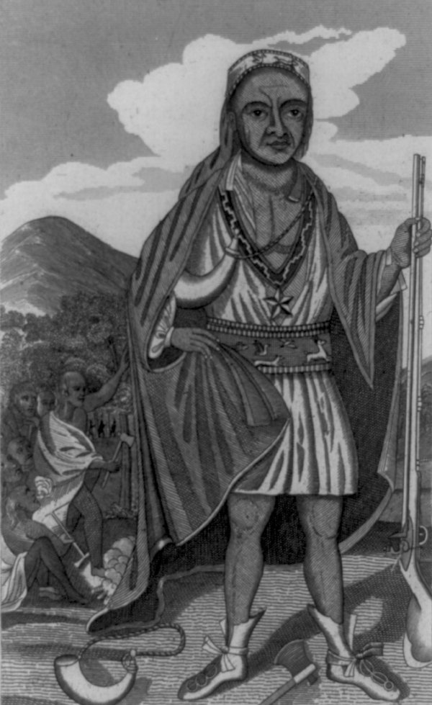
See It: Four Corners
Analyze the student’s Document 1 annotations in response to the prompt: What caused King Philip’s War of 1675?
Respond in your Handout:
What are the keys to exemplary Four Corners annotations?
How will Four Corners annotations influence the strength of historical discourse and writing?
2
Notes:
6 min/@min 2
To get us started, let’s examine what the Four Corners sourcing method looks like. On page 2 of your handout, you’ll find a primary source document marked up using the Four Corners method. Let me provide you with a bit of context. This document comes from an inquiry lesson on King Philip’s War, and students must use it to help them answer the prompt: What caused King Philip’s War of 1675? You may or may not be familiar with King Philip’s War, and that is okay for the purposes of this particular exercise. Your goal is to study the prompt, read the document and identify how the student used the Four Corners method to help them answer the prompt.
Please take the next 3 minutes to review the student sample and answer the following questions:
What are the keys to exemplary Four Corners annotations?
How will Four Corners annotations influence the strength of historical discourse and writing?
TW review for 2 min
TW T&T for 1 min
TW SO for 2 min
Great work, team. You’ve already identified much of what goes into annotating using Four Corners, but let’s ensure we’re all exactly on the same page by putting common language to it.

Slide 4

Name It: Four Corners
Sourcing:
Author’s Point of View:
Students consider the author’s name, geographical location, job/role, race, gender, political affiliation, etc.
Historical Context:
Students ID what they know about the topic and time period and push for precise academic vocabulary
Audience:
Students determine the type of source (ie. speech, letter, newspaper article, etc.) and the resulting intended viewers/readers/listeners
3
Notes:
2 min/@min 8
3 out of the 4 corners are connected to sourcing, and students should be able to fill these out fairly completely even before reading the document itself. They should use what they already know about the topic as well as their analysis of the source line to complete these 3 boxes, but they should obviously add more details as they see fit while they read the actual source.
For author’s POV: Students consider not just the author’s name, but also READ BULLET. This helps them to start thinking about the author’s potential motive and also results in students’ ability to begin thinking about any potential biases or limitations while also encouraging them to begin corroborating multiple sources.
Sometimes a document’s source line includes historical context. The scope– or dates– in the source line are the biggest hint about what students should be thinking about. They need to ask themselves what they know about this topic and time period, and they should brainstorm associated academic vocabulary connected to the period.
In order to determine audience, students need to start by asking what type of source they are considering. Is it a speech? A letter? A newspaper article? This will open the door to them being able to think through who the author may have wanted to listen to them.

Slide 5
Name It: Four Corners
Analysis:
Author’s Claim:
Students record a paraphrase of the sub-arguments and overall argument in the document
Author’s Purpose:
Students determine author’s motives by considering why the author chose this type of course to communicate this message at this time to this audience
Significance Statement:
Students answer the prompt and group sources for oral and written analysis
3
Notes:
1 min/@min 10
Once students have sourced their document, they can then read the actual body of the text itself. You named that there are not just four corners on this worksheet, but there are actually 2 other boxes as well as additional annotations on the page. We cannot divorce reading a document– or any primary source, regardless of format– from reading for the author’s claim.
While reading the text, students need to identify the key lines that demonstrate the author’s argument and then paraphrase them.
Only after they understand WHAT the author is arguing can they determine WHY the author is making that argument– or the author’s purpose. As a teacher, I found that this is the step that students most often struggled with. The jump from WHAT is being argued to WHY it’s being argument is pretty challenging, as it requires students to have a strong grasp of historical context and human motives. We don’t want to be reductive and settle for classic ELA author’s purpose notes like “to persuade” or “to educate.” In history class, understanding an author’s purpose requires students to understand the other 3 corners and the author’s claim at a very deep level.
Some of you pointed out the Significance Statement. We won’t be diving deep into those today, but they’re really important for students’ ability to corroborate. The SIG Statement essentially asks students to briefly answer the prompt. It’s a way for them to ID how a single document answers a prompt so that when they compare their sources, they can see how each one fits into the larger puzzle of building a historical argument in response to an inquiry prompt.

Slide 6

Do It: Four Corners
Let’s participate as students in an inquiry lesson! Listen carefully as your “teacher” guides you through the lesson. As you participate, consider:
How do the Four Corners help students to focus on sourcing?
How does the Four Corners annotation method help to support all learners in accessing historical materials?
Notes:
40 min/@min 11
Alright, we have a common understanding of what the Four Corners are and how they are connected to sourcing, but it’s impossible to feel the impact of using any teaching method without immersing ourselves in the learning. So let’s do just that!
We’re going to pretend we are middle schoolers preparing for a lesson on the true history of Thanksgiving. So let’s go ahead and turn to page 4 of our handout. AND SCENE!
Textbook Excerpt (5 min)
TW say: “Now as we’ve discussed before, textbooks often have biases and don’t often give a full picture of what happened in the past. Read the following textbook excerpt and annotate for author’s claim. As you read, ask yourself if this history feels correct and complete and if not, what you think may be missing.”
(You Do—3 min) SW read and annotate for author’s claims. TW academically monitor using the following laps:
Sub-claim Par 2: “Previously kidnapped Squanto used as an interpreter”
Say: You are missing a key idea, go back and make note of it
Mark: Bracket “Squanto, a local Indian…” to “a stellar corn crop”
Sub-claim Par 3: Alliance formed b/n Pilgrims and Wampanoags
Say: What was the relationship like between Indigenous peoples and the colonists?
Mark: Circle “alliance”
Sub-claim Par 3: Pilgrims celebrated to give thanks
Say: Why were they gathered?
Mark: Underline “had much for which…”
AC: There was great partnership between the Indigenous peoples and the colonists and they came together to celebrate and give thanks
Say: Synthesize your sub-claims to capture all of the arguments made
SW T&T (30 sec): According to the textbook, what really happened at the first Thanksgiving feast in 1621?
TW ask: This sounds great! I love learning the history of my favorite holidays! But I also know textbooks sometimes leave out the full truth. What do you think could be missing?
Prompt Breakdown (5 min)
TW cc a student to read today’s prompt: What really happened at the first Thanksgiving feast in 1621?
TW say: “Take the next 60 seconds to break down the prompt. Do this by determining what type of Historical Thinking you’ll be doing today– causation, comparison, change and continuity over time, etc. Then jot down everything you know about this topic already.
TW say: “I see that most of us had ‘argumentation’ down as our Historical Thinking Skill today, and many of us had numerous key terms and concepts we’ve learned about over the past several days, including Jamestown, Massachusetts Bay, Pilgrims, Puritans, Pequot War, King Philip’s War and Settler Colonialism. We are now ready to get to the bottom of this inquiry by digging into our sources. Today we have 2 sources, and we’ll have a short burst of discourse between our reading of each one. Please take the next 6 minutes to actively read Document 1, on page 5 of your handout. Be prepared to discuss!”
Document Analysis & Discourse (25 min)
See lesson plan
Exit Ticket (5 min)
· An Exemplar:
o Argument: Although most American students are taught that the Pilgrims were so grateful for Indigenous peoples that they shared their feast with them, it is more likely that the Indigenous people were not invited to the feast and only joined as to ensure their own safety.
o Evidence:
o Doc 1: Edward Winslow claimed that the Wampanoag were treated as guests during the first Thanksgiving, emphasizing that despite their hardships, the Pilgrims were generous in sharing their food (Doc 1).
o Doc 2: Ramona Peters argued that the Wampanoag arrived at the Pilgrims’ feast and stayed to ensure peace. During their stay, they hunted for and fed the Pilgrims because the Europeans relied on them (Doc 2)

Slide 7
Core Idea
By teaching students to source what they read, we teach them to do much more than comprehend a text.
We invite them to think like historians.
9

Slide 8

Final Reflection
How do the Four Corners help students to focus on sourcing?
How does the Four Corners annotation method help to support all learners in accessing historical materials?
9
Notes:
3 min/@min 51
And scene!
Let’s reflect on how the Four Corners supported our historical investigation today. Please take 2 minutes to reflect on page 9 of your handout.
2 min to reflect
1 min to SO
Thank you all so much for joining me today. If you have any questions or need further support in anything related to teaching Indigenous history, or in terms of the pedagogy you learned today, please reach out to me. My contact information is located on the front page of your handout.

