Slide 1
Teaching the Pequot War
Mashantucket Pequot Tribal Nation Curriculum, 2023
Notes:
1 min/ @ min 1
Good morning, everyone! My name is Rebecca Lord Gomez, and I am the Director of Education and Recreation for the Mashantucket Pequot Tribal Nation. Prior to this role, I was a History Curriculum Director for Uncommon Schools, a large charter school network in New York, New Jersey and Massachusetts. My true passion is history education, so I am so excited to welcome you to this session on teaching the Pequot War.
During our time together, we will immerse ourselves in 2 of the 7 lessons that the Mashantucket Pequot Tribal Nation has provided for Connecticut Teachers thus far this school year. We’ll focus on the content of these lessons by closely determining what the “most productive struggle,” or most challenging historical thinking, students will be doing during these lessons and how to prepare for that prior to the launch of class.

Slide 2
Opening Reflection
What resources have you used to teach about the Pequot War in your classroom?
How do you prepare to teach lessons grounded in student discourse?
2
Notes:
3 min/ @ min 1
You are probably in this room because you’ve either taught the Pequot War before, or you haven’t and are interested in doing so. Prior to working at Mashantucket, I taught the Pequot War as a 7th grade history teacher in Newark, NJ. It’s a pretty big deal in the scope of American history; many historians consider it to be one of the first turning points in our history. So let’s reflect on our experiences.
Take 1 minute to jot down the following on page 1 of your handout: READ Questions
1 min writing
1 min T&T

Slide 3
The Arc of Teaching History
Mashantucket Pequot Curriculum:
Approximately 25 lessons
4 “cycles”
Each cycle includes 3 stages
Current cycle= #3 out of 4
Period: 1614-1640
Other cycles will be released throughout this school year
Study the “Three Stages of History Instruction” one-pager on page 3of your handout and respond:
What are the 3 stages of history instruction in the Pequot curriculum?
How do these 3 stages help to build a layered understanding of Pequot history?
What questions do you have about the 3 stages?
3
Notes:
8 min/@ min 4
Before we can dig into the Pequot War as a topic and how to best teach heavily student-centered lessons, we first need to understand how the Pequot curriculum is designed. I am working with my curriculum writers to create approximately 25 lessons, all of which will be available to Connecticut teachers to fit into their curriculum in whatever way they see fit this year. These lessons will fit into 4 “cycles,” and each of these cycles has 3 stages. We’ll unpack what this means in just a moment.
Today, one of the 4 cycles is available to teachers. It is not cycle 1, which will be the earliest period in Pequot history, but instead, is cycle 3, which centers on the period 1614-1640. The Pequots felt that this period was crucial to begin with, not only because it’s imperative to understanding so much about Mashantucket today, but also because whether anyone likes it or not, the Pequot War is what is most often taught about the Pequot people in American history classrooms. We might as well get the narrative right!
The other 3 cycles will be released this year, beginning with cycle 4, which will cover federal recognition and the modern day.
So what do I mean by cycles and stages? Let’s take a look. On page 3 of your handout, you’ll find a document that is also posted on GoOpen CT right now. Please take 4 minutes to review it and answer the following questions: READ
4 min silent review and writing
1 min T&T
2 min SO

Slide 4
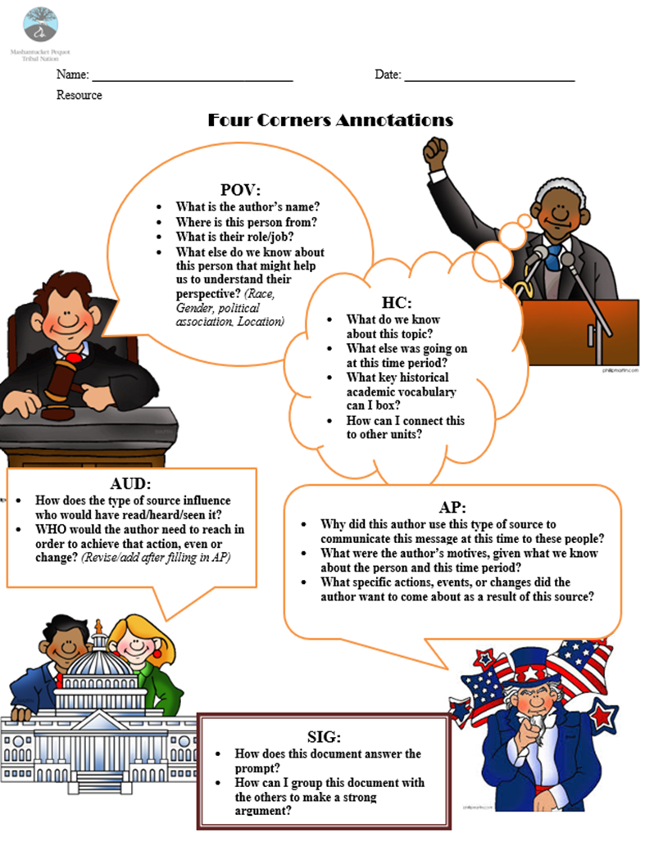
The Four Corners
Sourcing is crucial for historians!
When reading primary sources, students need to consider:
Author’s Point of View
Historical Context
Intended Audience
Author’s Purpose
Learn more at my second session today!
4
Notes:
2 min/@min 12
One more extremely important note for all of us prior to digging into the Pequot War curriculum.
Read slide
You’ll find a copy of the Four Corners resource on page 4 of your handout, as well as on GoOpen CT. I will be doing a full session this afternoon on the Four Corners, so to learn more, please join me! We’ll undergo an inquiry lesson simulation to feel what sourcing documents in this way feels like for students! But we all need a baseline understanding of what the Four Corners are and the function they play in primary source analysis to access our time together this morning.

Slide 5
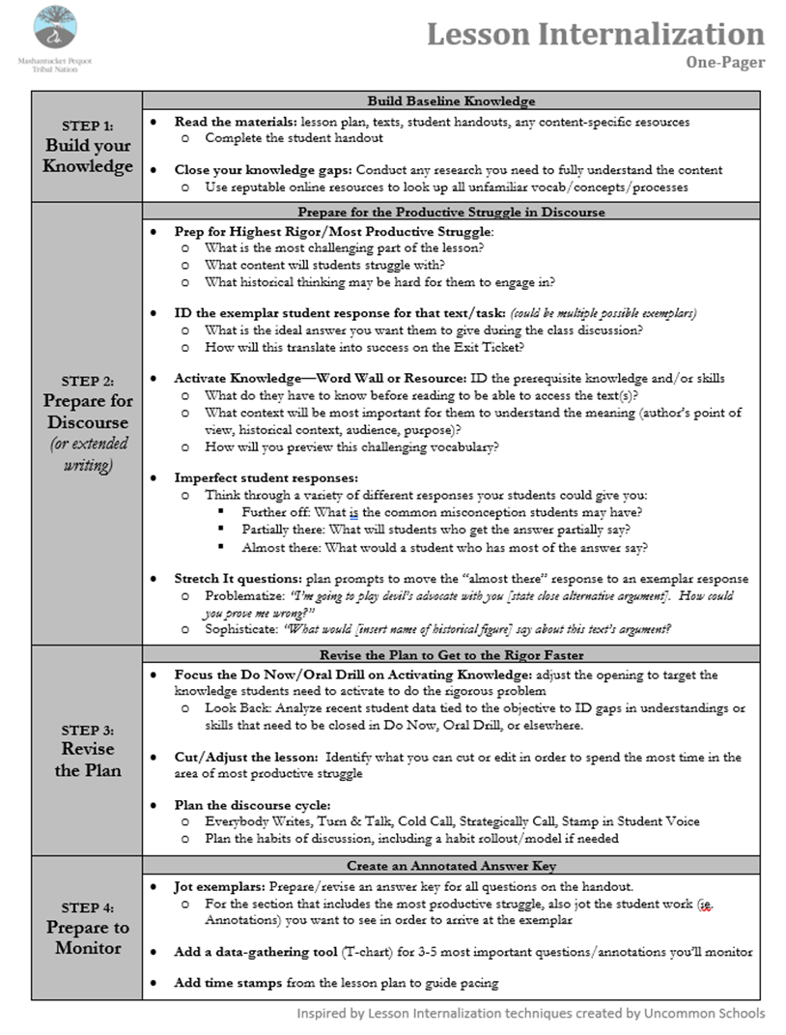
See It: Lesson Internalization
Study the “Lesson Internalization” one pager on page 5 of your handout and respond:
What are the 4 steps of the lesson internalization process?
Why does lesson internalization matter?
5
Notes:
6 min/ @ min 14
We’ve all taught many history lessons, and we all know that good teaching– regardless of content area– requires strong preparation. In order to help us access a lesson on the Pequot War today, we are going to start by identifying how to best internalize a lesson.
On page 5 of your handout, you’ll find a “Lesson Internalization” one-pager. Please take 3 minutes to skim it and answer the following questions: READ
3 min to read
1 min T&T
2 min SO

Slide 6
Name It: Lesson Internalization
Build Your Knowledge:
Carefully read the provided lesson materials
Close your knowledge gaps by researching
Prepare for Discourse:
Identify the most productive struggle
Determine exemplar responses
Revise the Plan:
Adjust “First 15” to ensure proper knowledge is activated
Cut/adjust lesson
Plan discourse
Prepare to Monitor:
Record exemplars
Add data gathering tools
Add time stamps
5
Notes:
1 min/@ min 20
You’ve pretty much named them all. We want to: READ

Slide 7
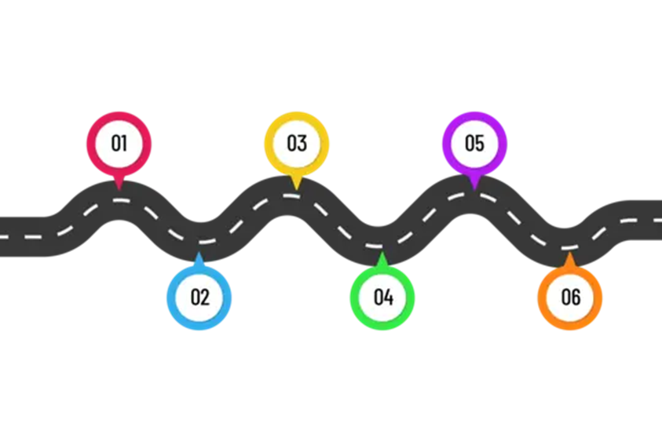
Core Idea
When you have the destination, you can set the roadmap.
5
Notes:
1 min/@ min 21
And this brings us to our first Core Idea of the day: Read
As a first year teacher in the South Bronx, I remember being told: “If you don’t have a plan for your students, they’ll have a plan for you!” And this doesn’t just mean having an activity for them to complete. It includes having a clear, rigorous destination that we thoughtfully prepare to navigate them towards.

Slide 8
Name It: The Most Productive Struggle
The Most Productive Struggle is:
The point in the lesson where students may struggle the most
The place where historical thinking is most featured
A key line or how texts corroborate one another in a way that unlocks meaning
By identifying the Most Productive Struggle:
We can be clear on what to monitor for
Pacing is tighter, allowing us to go deeper and farther with students
Our feedback directly supports the most challenging and important aspect(s) of class
6
Notes:
3 min /@min 22
In our one pager under Step 2: Prepare for Discourse, we are asked to prep for the most productive struggle of the lesson. Before we can do this in our Pequot War lesson, we first need to identify what we mean by the most productive struggle is.
Call on 2 readers to read the slide.
We know that all lessons have objectives: the skills or content we want students to be able to master. But what about a particular lesson unlocks this learning for our kids? By taking the time to identify what it actually is about the lesson that will allow kids to grapple as historians, we help them to grow in their understanding of what we are teaching them and the discipline of history at large.

Slide 9
Do It: The Most Productive Struggle
Take 10 minutes to skim through the two lessons on the Pequot War. Review the lesson plans and the student-facing materials. Then determine:
What is the most productive struggle in this lesson?
What will students most struggle with?
Where do they most need to think like historians?
Where in the documents will students feel most challenged?
What about how the documents fit together may most challenge the students?
What do you believe is the ideal student response to the most productive struggle in this lesson?
What would your most successful students be able to take away from the lesson?
What does success look like by the end of day 2?
LESSONS: https://shorturl.at/dswE3
6
Notes:
12 min/@min 25
Finding the Most Productive Struggle in a lesson is not always easy! So let’s try it out. You each have a copy of the 2 lesson plans and student-facing materials on the Pequot War. Take the next 10 minutes to skim through the two lessons and determine: ASK QUESTIONS
Please note that I recognize reviewing 2 full lesson plans takes FAR more than 10 minutes. For me, it took at least an hour of intellectual prep for each hour of class I taught. The goal for right now is to just practice applying our new learnings as you familiarize yourself with the tools the Mashantucket Pequot Tribal Nation is providing you this year.
10 min Prep
1 min T&T

Slide 10

See It: Plan for the End Goal
Study Mrs. Marvania’s intellectual prep by reviewing her Monitoring Document on pages 7-8 and determine:
How did this teacher successfully prepare students to grapple with the most productive struggle?
What else do you notice about the teacher’s intellectual prep?
7-8
Notes:
8 min/@min 37
Once we have identified the Most Productive Struggle, we need to determine how to help our students get there. One of the best ways to do this is to create a Monitoring Key. Now, for any people who use a curriculum with regular student-facing materials, this is more straightforward, and will look a lot like the tool that we are about to review. For those of you who do not generally use student handouts, I encourage you to think about what this could look like in your classroom, as I’ve seen it done so many different ways and it truly is a personal choice about what works best for any individual educator.
On pages 7-8 of your handout, you’ll see a teacher named Mrs. Marvania’s intellectual prep on the Pequot War lesson you just studied. Take 4 minutes to review it and answer the following: READ QUESTIONS.
4 min silent work
1 min T&T
2 min SO

Slide 11
Name It: Plan for the End Goal
Identify the most productive struggle
Backwards plan and align to the most important parts of this struggle
“Do not pass go” moments
Monitor student work carefully for these 4 key elements:
ONE of the Four Corners (POV, HC, AUD or AP)
Does the student have the sourcing needed to understand the text as a historical document?
ONE key line in a text
Did the student identify the key line that unlocks the meaning?
Author’s Claim
Did the student comprehend the text?
Significance Statement
Has the student determined how the text helps to answer the prompt?
7-8
Notes:
2 min/@min 45
You’ve pretty much named everything we need to do to plan for the end goal.
READ SLIDE

Slide 12
Core Idea
Don’t take away the struggle.
Make it productive.
9
Notes:
1 min/ @ min 47
This brings us to a second core idea: READ
Learning is messy. It shouldn’t necessarily always be easy, and in history, there rarely is one correct answer or one way of thinking. That is exactly why we want our students to struggle, but struggle without support or intention is scary and even harmful.
We don’t want to remove the struggle, but we do need to make it productive so that despite the challenges of navigating difficult historical content, our young historians feel the success of growing their brains.
Therefore, by planning for how to help students successfully tackle the Most Productive Struggle through our Intellectual Prep, we set students up for great success.

Slide 13
Do It: Plan for the End Goal
Take 6 minutes to start creating a monitoring key. Determine:
What is the exemplar for the most productive struggle?
Where along the way do you need to monitor to get students there? Consider:
One of the Four Corners
A key annotation in the text(s)
Author’s Claim
Significance Statements
Which students will you monitor for?
Include students who believe will have an exemplar, students who will be almost there, and students who may be farther off
How will you collect data?
What are short prompts you will use to get students on track?
Notes:
6 min /@min 48
Let’s start this process together. Please take the next 6 minutes to begin creating a monitoring key for yourself for this lesson. READ SLIDE
5 min silent work

Slide 14





Resources to Consult
Notes:
1 min/ @min 54
I want to thank you all for engaging in intellectual prep on a very important set of lessons this morning. I want to leave you with some resources that I used to help shape the Pequot curriculum. QUICKLY REVIEW

