Slide 1
The Treaty of Hartford of 1638
The Resistance and the Resilience of the Pequot People in the Face of Attempted Genocide
“Declaring Freedom” Youth Conference
Central Connecticut State University
March 13, 2024
Notes:
Good morning! As I said, my name is Rebecca, and I’m really excited to dig into a really fascinating and important historical document with you all today. Raise your hand if you have heard of the Treaty of Hartford of 1638? Just as I suspected: it’s rarely taught about in schools, although it should be! I think you’ll find that our investigation today will be really interesting!
During our time together, we are going to learn some background knowledge and then we’ll apply that context to a close reading of this document. I ask that during our time together, you engage as fully as possible. There will be times when I ask for volunteers to read and give some answers, but there will also be times when I cold call some of you. Our mutual success will depend on participation from the full group!
Is this something we can all commit to today?

Slide 2
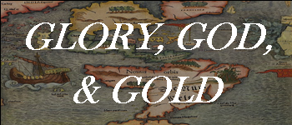
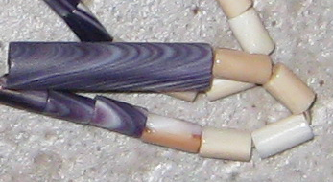
European Invasion
1607: English Arrive in Virginia
1620: English Pilgrims Arrive in New England
1623: Dutch arrive in New York
1630:
  English Puritans arrive in New England
  Pequots become close trading partners with the Dutch
    Cloth, metal tools, firearms → furs & wampum
Winter-Spring 1634:
  Small Pox Epidemic
  Pequot and Narragansett battle periodically
Notes:
Let’s begin by building a bit of historical context about the European Invasion of what is now called the United States. Many of you have heard at least pieces of this story. You can feel free to take notes in your handout!
READ

Slide 3
The Pequots and the Mohegans
Two of many tribes in Southeastern New England
Both interacted with English and Dutch colonizers
Principal sachems:
  Mohegan: Owaneco
  Pequot: Tatobem
Other key players:
  Mohegan: Uncas, son of Owaneco
  Pequot: Sassacus, son of Tatobem
Notes:
We are going to deep dive into history specific to this story, beginning with an understanding of the Pequots and the Mohegans, two Tribes in what is now called Southeastern Connecticut that actually began as one Tribe.
(click) At the time of European contact, there were many Indigenous people residing in what is now called New England. Up until the 1620s, they went by the name Pequot, but as we will learn, they divided into multiple Tribes when the British arrived. In the region of what is now called Southeastern Connecticut, two of the Tribes were and still are called the Mohegans and the Pequots.
(click) These two Tribes, along with many other Indigenous residents of Northeastern North America, interacted with European colonizers. In this particular region, they primarily traded with first the Dutch, then the British.
After the split of the Tribes in the 1620s, the leaders of the Mohegan and Pequot Tribes were very powerful, and they recognized that a balance of power between the two communities was beneficial. Despite this, there was a history of intense power struggles. That is why the sachems, leaders of the Tribes, created alliances in many ways: to attempt to settle those power struggles and create peace. To set the scene, let’s introduce ourselves to the key leaders in this story.
(click) In the 1620s, the principal sachem of the Mohegan Tribe was Owaneco, and the principal sachem of the Pequot Tribe was Tatobem.
(click) Of course, Owaneco and Tatobem had other members of their Tribes who supported them. In today’s story, we’ll focus on a Mohegan man named Uncas, the son of Owaneco, and a Pequot man named Sassacus, the son of Tatobem.

Slide 4
Pequot Authority
1626:
  Owaneco arranges for Uncas to marry Tatobem’s daughter
  Owaneco dies shortly after
  Balance of power tips toward Pequots
1633: Tatobem captured & killed by Dutch
  Sassacus becomes his successor
  Uncas feels he should be sachem
Notes:
(click) Our story begins in 1626, after the split of the Pequot people into two Tribes, the Mohegan and the Pequot. At this time, Mohegan sachem Owaneco arranges for his son Uncas to marry Pequot sachem Tatobem’s daughter. Remember, we said that the alliances between the two Tribes was based on a balance of power because of the splitting and following divisions, so this was an important political move happening in the context of the intrusion of outsiders from Europe. It makes sense that the two sachems wanted peace, and intermarrying was a key way to facilitate that peace.
(click) Unfortunately, shortly after the marriage took place, Uncas’s father and chief sachem of the Mohegan, Owaneco, dies. (click) With the death of the Mohegan sachem and Uncas’s marriage into the Pequot family, that balance of power tipped to the Pequots.
Ask: What would you do if you were Uncas? Take a few hands
Uncas mourned the death of his father, but he was unwilling to challenge the power of Tatobem. He did contest the Pequot authority over the Mohegan, but didn’t make major moves to try to take power into his own hands.
(click) That is, until Tatobem died. In 1633, Tatobem was captured and killed by the Dutch. He was held for ransom for 50,000 wampum, which the Pequot paid. Nevertheless, the Dutch murdered him. Uncas saw this as his moment to try to end that Pequot authority over the Mohegan, but (click) Sassacus was determined to be the successor of Tatobem, not Uncas, because Sassacus was Tatobem’s natural-born son and Uncas’s marriage into the family did not give him the right to leadership. (click) This enraged Uncas. After all, he had married into the family of the Pequot sachem and thought that he had just as much of a right to the sachem role as Sassacus.

Slide 5
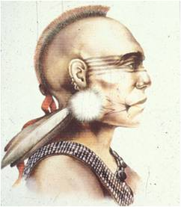
The Rebellion
1634: Uncas rebels against Sassacus
  Has Narragansett support
  Defeated; exiled
1635: Uncas allies with Puritans
  Relationship with John Mason
  Tells Jonathan Brewster of Sassacus’s plans to attack colonists on CT River
Sassacus
Notes:
(click) Although he had been unwilling to rebel against Tatobem, Uncas was less shy about doing so against Sassacus. (click) In 1634, with the support of a Tribe called the Narragansetts who lived in what is now called Rhode Island, he rebelled against the new Pequot sachem, but was quickly defeated. (click) Upon his defeat, he chose to leave his adopted Pequot family and went into exile among the Narragansetts, whom he was more aligned with in regards to how to deal with the British. He had humiliated himself before Sassacus, but was not prepared to give up his quest for power. He attempted rebellion again, but his failed challenges resulted in Uncas having little land and few followers. Uncas needed another plan.
(click) In the 1630s, a slew of British colonists had started to arrive in the region. Though few in number, they had better weapons and much courage. Uncas saw an opportunity. In 1635, he established a partnership with the Puritans in the hopes of obtaining his ultimate goal of become Grand Sachem.
(click) To do this, he became a trusted ally of Captain John Mason, whom we will learn more about in the coming days. (click) He also sent word to British colonist Jonathan Brewster that Sassacus was planning to attack the colonists on the Connecticut River. Impressed with his willingness to betray his Pequot family, Uncas was deemed “a friend of” and “faithful” to the colonists.

Slide 6
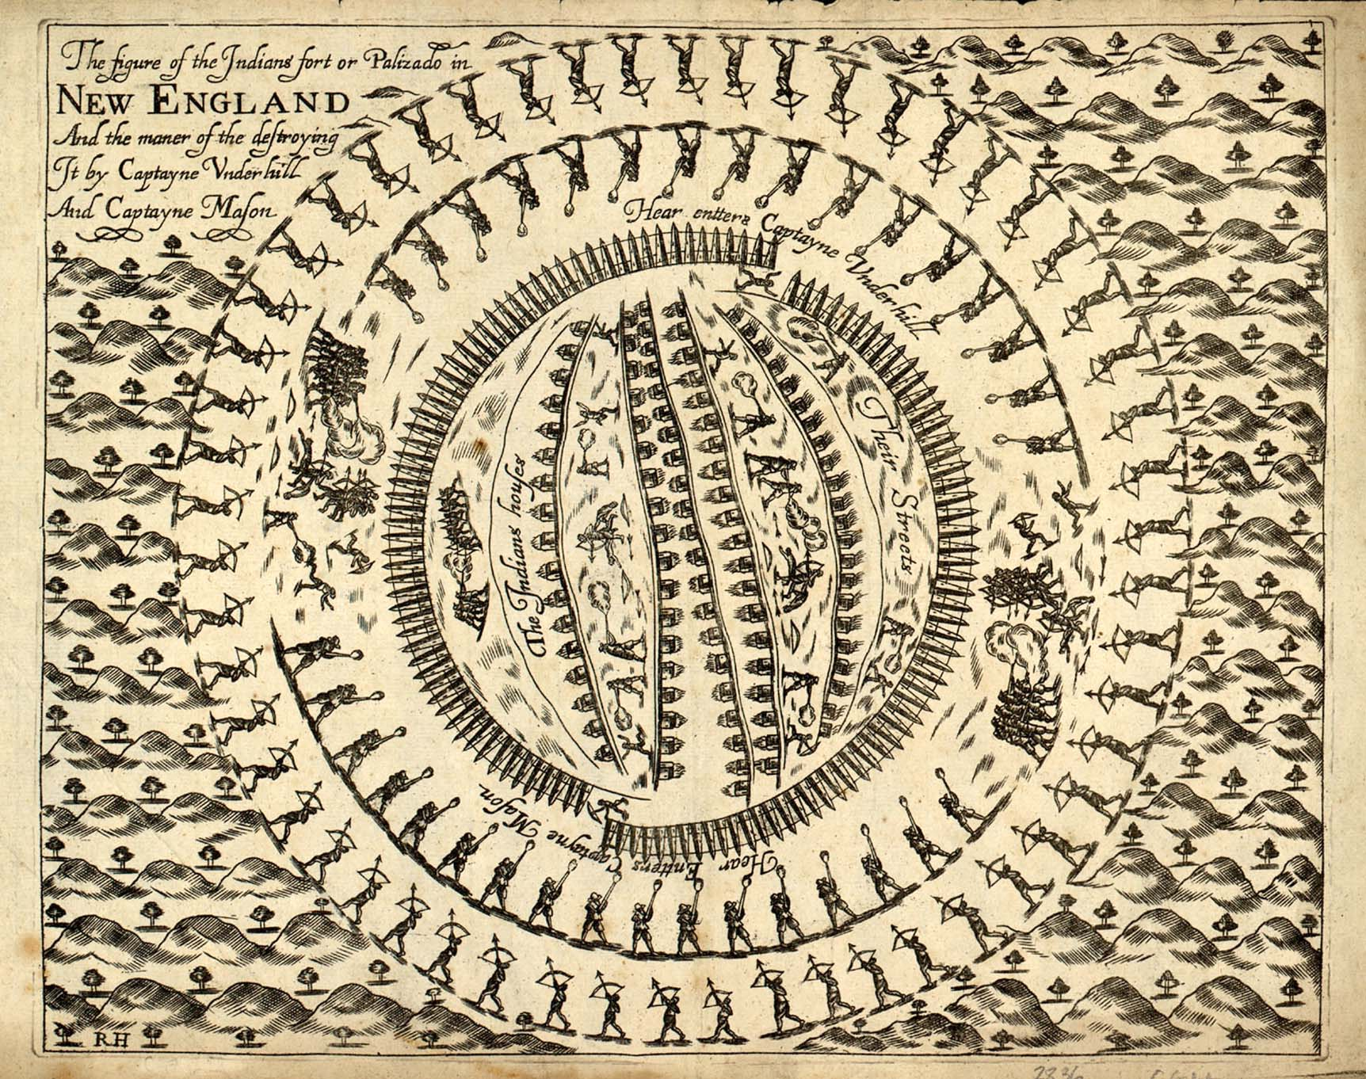
The Pequot War (1636-1638)
Uncas allies with New England colonists against the Pequots
Mohegans participate in British attack against the Pequots near Saybrook and massacre at Mystic
The result is the attempted genocide of the Pequot people
John Underhill’s engraving depicting the Mystic Massacre of 1637
Notes:
(click) Uncas’s partnership with the British continued into the conflict called the Pequot War of 1637. (click) He allied with the New England colonists against the Pequots in attack after attack, including the key attack near Saybrook and the infamous massacre at Mystic.
(click) The culmination of these attacks was the murder and enslavement of over 1,500 Pequot, including innocent women and children. It was attempted genocide, and it had devastating effects on the Pequot people.

Slide 7
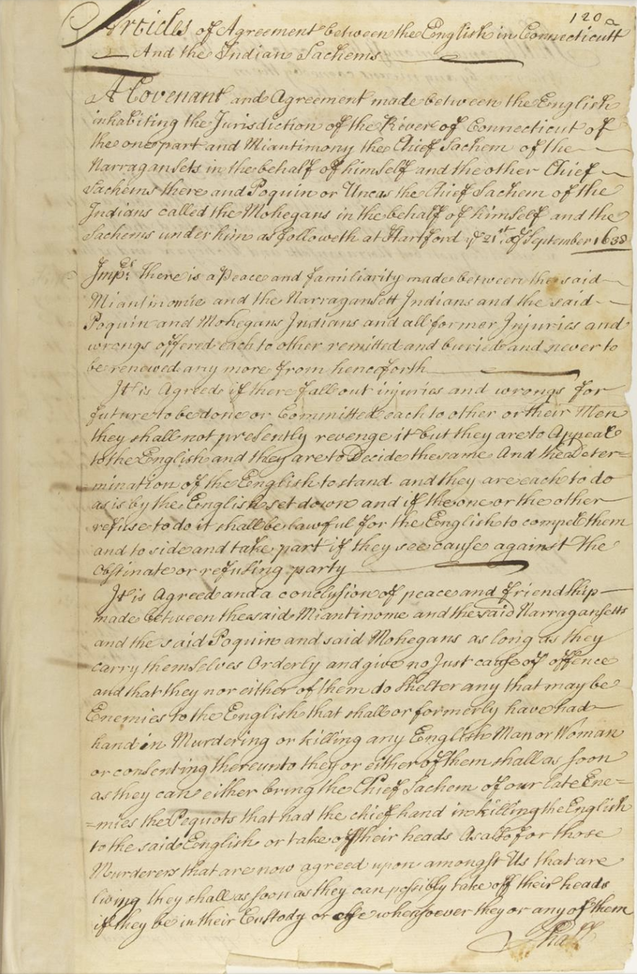
The Aftermath of the War
1638: Treaty of Hartford ended the war
  Signed by English, Mohegans and Narragansetts
1638 Treaty of Hartford
Who benefitted from this Treaty and who ultimately would suffer?
What did the Treaty actually do and how did it impact the Pequot people?
Notes:
The Pequot War, war was fought in 1636–37 by the Pequot people against a coalition of English settlers from the Massachusetts Bay, Connecticut, and Saybrook colonies and their Native American allies (including the Narragansett and Mohegan). It was an especially brutal war and the first sustained conflict between Native Americans and Europeans in northeastern North America. The war lasted 11 months and involved thousands of combatants who fought several battles over an area encompassing thousands of square miles. In the first six months of the war, the Pequot, with no firearms, won every engagement against the English. Both sides showed a high degree of sophistication, planning, and ingenuity in adjusting to conditions and enemy countermeasures. Indeed, the English suffered dozens of casualties in the early stages of the war before they were able to adapt their Old-World military experiences to the battlefields of the New World and win decisive engagements. In the end, the Treaty of Hartford, signed in 1638 by the English, Mohegan and Narragansett tribes, officially ended the Pequot War and forever changed the political and social landscape of southern New England, and it influenced colonial and U.S. policies toward Native Americans for centuries. The massacre of the Pequot at Mystic demonstrated to all observers, in southern New England and elsewhere, the English ability and will to wage total war against their Indian enemies.
Today, we are going to study that Treaty and ask ourselves:
(click) Who benefitted from this treaty and who ultimately would suffer the immense burden of this destructive war?
What did the Treaty of Hartford actually do and how did it impact the Pequot people?

Slide 8
Treaty of Hartford (1638)
“binding formal agreement or contract between two or more subjects of international law.”
Pre-Reading Questions:
  What is a treaty?
  Based on this definition, what can we assume will be in this treaty?
Source Line:
“Articles of Agreement between the Colony of Connecticut and the Indian sachems, Dated 1638.”
  From whose Point of View was this document written?
  What Historical Context do we need to consider when reading this document?
  Who is the intended Audience?
Notes:
In preparation for today, you were asked to read the Treaty of Hartford. Whether you were able to read it carefully or not, I want to empower you to pay close attention to our discussion of this document, knowing that all of us will have a chance to review the text now. Remember our commitment to engage fully at the beginning of today’s session!
(click) So let’s begin with a pre-reading question. Turn and tell your partner: What is a treaty?
SW T&T (1 min)
Take 1-2 hands to share
Very nice. Let’s put some formal language to this. (click) According to Britannica, a treaty is a “binding formal agreement or contract between two or more subjects of international law.”
(click) Based on this definition, what can we assume will be in this treaty?
SW T&T (1 min)
Take 1-2 hands to share
Interesting hypotheses!
Great historians know that the message of a text isn’t the only important part of our reading. We always start with the source line so that we can begin to unpack the truly purpose of a source. (click)
Call on a student to read the source line.
Ask 3 questions.

Slide 9
Treaty of Hartford (1638)- Paragraph 1
A covenant and agreement made between the English inhabiting the jurisdiction of the River of Connecticut of the one part and Miantonomo, the Chief Sachem of the Narragansetts, in the behalf of himself and the other chief sachems there, and Poquiam or Uncas, the Chief Sachem of the Indians called the Mohegans, in the behalf of himself and the sachems under him, as followeth at Hartford, the 21st September 1638.
  How does this paragraph help to add to our understanding of sourcing?
  What do you predict will be included in the rest of the treaty?
Notes:
We’re going to proceed by reading the text itself. I’m going to ask for volunteers to read the paragraphs. As we read, you may choose to mark up the text on your worksheet, or you can follow along up here on the power point. Just be prepared to discuss!
For each chunk of text, I’ll give you a few guiding questions. As we read paragraph 1, please consider:
How does this paragraph help to add to our understanding of sourcing?
What do you predict will be included in the rest of the treaty?
Call student to read paragraph 1
Ask:
How does this paragraph help to add to our understanding of sourcing? The Pequots were excluded from the Treaty.
BID:
Whose voice is missing from the creation of this treaty?
Why does that matter?
What do you predict will be included in the rest of the treaty? Punishment of Pequots

Slide 10
Treaty of Hartford (1638)- Paragraph 2
“First, there is a peace and familiarity made between the said Miantonomo and the Narragansett Indians and the said Poquiam and Mohegan Indians and all former injuries and wrongs offered each to other remitted and buried and never to be renewed anymore from henceforth.”
  What stipulation does this paragraph include?
  Why might this stipulation be included in the treaty?
  In the Pequot War, the Narragansetts and Mohegans were on the same side. Why is this stipulation necessary?
Notes:
(click) What stipulation does this paragraph include? The two Tribes will forget their past conflicts and never have issues between each other again.
Why might this stipulation be included in the treaty? It benefits the Tribes because it creates the goal of getting along, but it also benefits the English because they won’t have to navigate more conflicts between Tribes
(separate click): In the Pequot War, the Narragansetts and Mohegans were on the same side. Why is this stipulation necessary? The English want to prevent more conflicts from taking away what they believed was their land to control.

Slide 11
Treaty of Hartford (1638)- Paragraph 3
“they shall not presently revenge it, but they are to appeal to the English, and they are to decide the same, and the determination of the English to stand, and they are each to do as is by the English set down…”
“[Second,] it is agreed if there fall out injuries and wrongs for future to be done or committed each to other or their men, they shall not presently revenge it, but they are to appeal to the English, and they are to decide the same, and the determination of the English to stand, and they are each to do as is by the English set down, and if the one or the other refuse to do, it shall be lawful for the English to compel them and to side and take part if they see cause against the obstinate or refusing party.”
  What happens if the Narragansetts & Mohegans have a conflict?
  Why might this stipulation be included in this treaty?
  In the Pequot War, the Narragansetts and Mohegans were on the same side. Why is this stipulation necessary?
Notes:
What does the treaty name happens if the Narragansetts and Mohegans have a conflict? Talk to me in text. (click) “They shall not presently revenge it, but they are to appeal to the English, and they are to decide the same, and the determine of the English to stand, and they are each to do as is by the English set down.”
Why might this stipulation be included in this treaty? Who does it benefit? It gives the power to the English. They get to control what happens if other signing parties come into conflict.
(separate click) In the Pequot War, the Narragansetts and Mohegans were on the same side. Why is this stipulation necessary? The English want to prevent more conflicts from taking away what they believed was their land to control.

Slide 12
Treaty of Hartford (1638)- Paragraph 4
[Third], it is agreed and a conclusion of peace and friendship made between the said Miantonomo and the said Narragansetts and the said Poquiam and said Mohegans as long as they carry themselves orderly and give no just cause of offense and that they, nor either of them, do shelter any that may be enemies to the English that shall or formerly have had hand in murdering or killing any English man or woman or consenting thereunto. They, or either of them, shall as soon as they can, either bring the chief sachem of our late enemies, the Pequots, that had the chief hand in killing the English, to the said English or take off their heads. As also for those murderers that are now agreed upon amongst us that are living, they shall, as soon as they can possibly, take off their heads if they be in their custody or else wheresoever they or any of them shall come amongst them or to their wigwams or anywhere if they can by any means come to them.
  What stipulation does this paragraph include?
  Why might this stipulation be included in this treaty? Who does it benefit?
  In the Pequot War, the Narragansetts and Mohegans were on the same side. Why is this stipulation necessary?
“take off their heads…”
Notes:
What stipulation does this paragraph include? Surrender any enemies—namely Pequots—to the English or “take off their heads.”
BID: What is meant by “take off their heads”? Decapitate them- kill them by cutting of their heads.
Why might this stipulation be included in this treaty? Who does it benefit? It benefits the English primarily because they are directing the Narragansetts and Mohegans to give them power and/or to murder additional Pequots.

Slide 13
Treaty of Hartford (1638)- Paragraph 5
“give unto…”
Fourth, and whereas there be or is reported for to be said Narragansetts and Mohegans, two hundred Pequots living that are men besides squaws and papooses, the English do give unto Miantonomo and the Narragansetts to make up the number of eighty with the eleven they have already and to Poquiam his number and that after they, the Pequots, shall be divided as aforesaid, shall no more be called Pequots but Narragansetts and Mohegans, and as their men, or either of them, are to pay for every sannup one fathom of wampum peage, and for every youth half so much, and for every sannup papoose, one hand to be paid at hilling time of corn at Connecticut yearly and shall not suffer them for to live in the country that was formerly theirs but now is the English by conquest.
“shall no more be called Pequots but Narragansetts and Mohegans…”
Notes:
(click) In this stipulation, the English “give unto” the Narragansett and Mohegan sachems Pequots. What does this mean? They are enslaving the Pequots and giving them to the other Tribes
(click) The Treaty also says that they “shall no more be called Pequots but Narragansetts and Mohegans.” What is the consequence of stripping the Pequot people of their name? Why do names matter? Names matter tremendously because they are a key identity marker. If the Pequots can no longer be Pequots, but instead must be called the name of the Tribes who helped to commit genocide against them, they are being forced to lose a huge part of who they are. This is called “cultural genocide”: survivors are not physically dead, but they are compelled to see their culture extinguished.
Consider what we learned about Sassacus and Uncas and the conflict between the Mohegans and Pequots. How does this make the “cultural genocide” of the Pequots even more heartbreaking? The fact that another Tribe that was actually once part of the Pequot Tribe is participating in this genocide is heartwrenching.
Stipulations 1-3 show a distrust of the Mohegan and Narragansetts by the English. Why would the English trust these two Tribes to enforce the cultural genocide outlined in this Treaty? Answers will vary

Slide 14

Treaty of Hartford (1638)
  Group Discussion
Notes:
We named that the goal of the Treaty of Hartford—in fact, any treaty—was to create peace. Thumbs up if you agree that the Treaty of Hartford does this. Thumbs down if you disagree.
TW call on 2 students to support each side, starting with agree
One could argue that the treaty does indeed bring about peace, as it ends the war and punishes the group that lost—the Pequot. Agree or disagree?
Agree: The Pequot lost their name, land, language, and so much more. That resulted in peace because there was no more fighting.
Disagree: The war may have ended, but subjecting a group of people to slavery and stripping them of their culture is not a mark of peace.
What other evidence do we have to support the idea that the Treaty of Hartford was actually NOT intended to create peace in the region?
Second stipulation: In the case of conflict between Indigenous tribes, they must go to the English to mediate. This isn’t peaceful- it’s empowering one group over the other.
Break It Down Question: Consider the second stipulation. It names that if the Mohegan and Narragansett come into conflict with one another, they should have the English help them to mediate, or resolve, the issue. Why might this be good evidence to support that the English did NOT seek peace?
Third stipulation: The Narragansetts and Mohegan are friends of the English ONLY if they act in a way the English approve of. They are not allowed to shelter the Pequot or other enemies of the English. In fact, they are instructed to behead these enemies
Break It Down Question: Consider the third stipulation. What does this say about the Mohegan and Narragansett relationship with the English?
Fourth stipulation: The Narragansett and Mohegan are not permitted to own Pequot land, and the two tribes are not permitted to ever hold the English captive, essentially barring them from ever taking military action against the English, even though they were allies and the English had no reason to believe these tribes would do so.
Break It Down Question: Consider the fourth stipulation. The Mohegan and Narragansett helped the English with the war. Why can’t they have any Pequot land, and why would the English feel the need to name that they cannot take English people captive?
A treaty is a formal, legal agreement between parties. Are all relevant parties included in this treaty? Why does this matter? No, the Pequot were not included in the treaty. This inevitably means that the treaty cannot be peaceful, as a key group is left out of the agreement.
Drop the Knowledge: In 1666, the Pequot obtained a reservation, a set aside piece of land upon which they could reside. It was much smaller than the lands they called home prior to the Pequot War, but it was established nonetheless. What does this tell us about the Treaty of Hartford? The English’s ability to completely dominate Connecticut did not last very long. Just 28 years after naming that the Pequot people could not exist, they started the long battle to win back their cultural identity, beginning with their land.

